Slide 1

IDENTIFYING EMERGENCY VEHICLE USING DEEP LEARNING AUDIO CLASSIFICATION TECHNIQUES
- VijayKumar Reddy

Slide 2

Types of Audio Signals
There are two different types of audio signals: Analog and Digital signals.
An Analog signal is a continuous wave that changes over a period of time. An infinite number of samples exists between any two consecutive time instances.
Digital signals are a discrete representation of a signal over a period of time. Here, only a finite number of values exist between any two consecutive time instances. The signals can have only one value at any point in time: either 0 or 1 i.e are binary. It can also be said that it is a discrete wave that carries information in binary form.

Slide 3
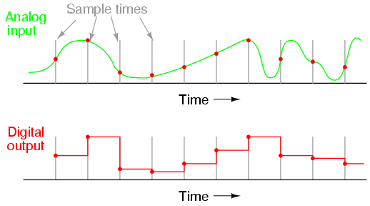
Conversion of Audio Signals
To work on a business problem related to audio data and to process the audio signals, we would need to convert the analogue signals to digital signals. The way to do so is via Sampling.

Slide 4
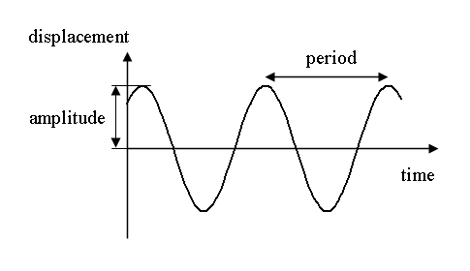
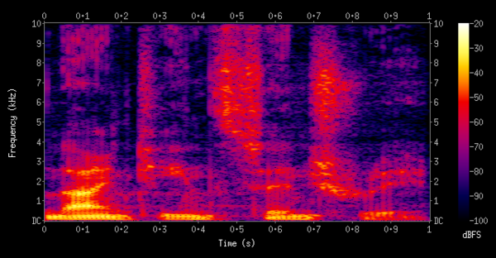
Audio Signals Representation
1. Time Domain
In the time domain, the audio is represented by the amplitude (which is represented) as a function of time i.e. amplitude is recorded at different intervals of time. In simple words, it is a plot between amplitude and time.
X-axis: time, and
Y-axis: amplitude
2. Spectrogram: A spectrogram , another audio representation, is a two-dimensional (2D) plot between time and frequency having a third dimension, which exhibits colors. Each value of the spectrogram represents an amplitude of the frequency at a particular time in terms of intensity colors

Slide 5
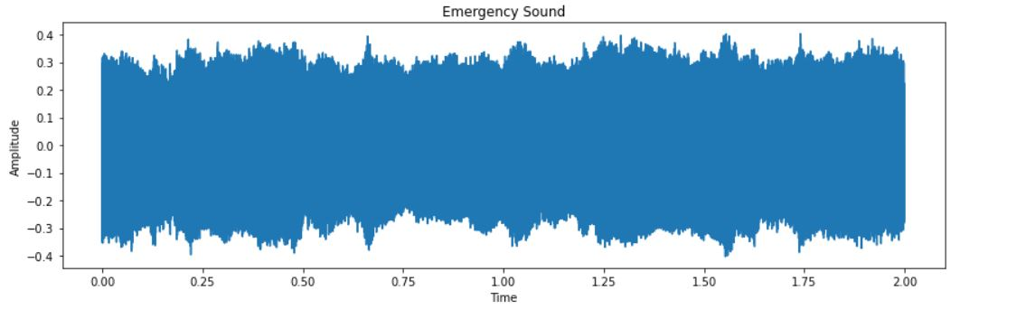
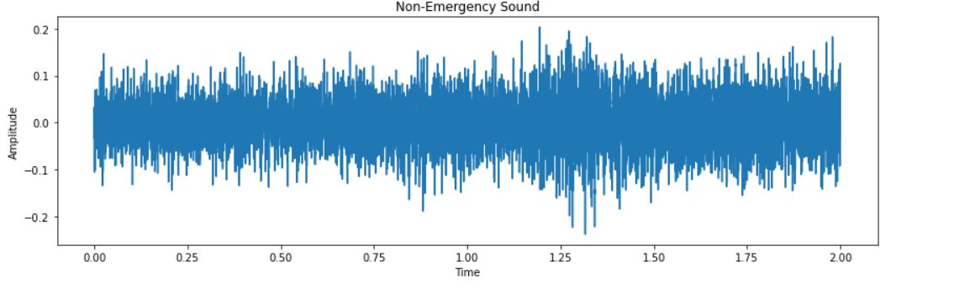
Visualizing the Audio Data : Time Domain

Slide 6
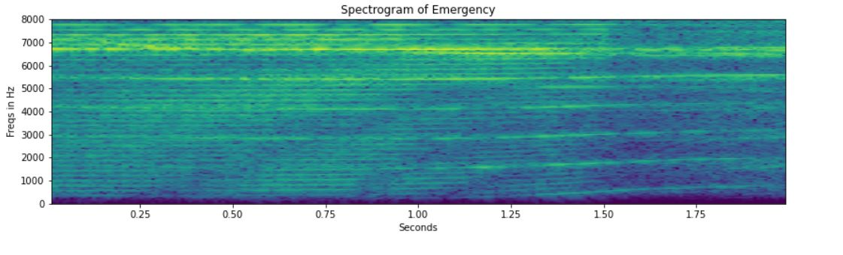
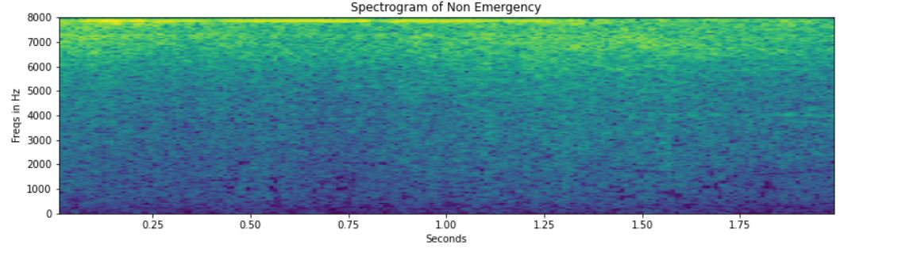
Visualizing the Audio Data : Spectogram

Slide 7

Techniques that were used
Audio classification using Time Domain features
1)Long short-Term Memory
2)Convolutional Neural Network
Audio classification using Spectogram features
1)Long short-Term Memory
2)Convolutional Neural Network

Slide 8
Model Building using LSTM
The shape of the input sequences is 32000. 32000 samples are meaning there will be 32000-time steps (to deal with) in every audio chunk. This can lead to a lot of time to train, and the vanishing gradient descent problem can also come into place.
So, to overcome this, I have used a simple trick while reshaping the chunks below. Instead of keeping the length of the features (the third dimension) as 1, I will use 160 which will reduce the timesteps from 32000 to just 200, and then I can easily use these reshaped sequences in our model.

Slide 9
Model building ( Using CNN)
Working with the voice or audio data, we use Conv1D as it is used for input signals which are similar to the voice. Building the model with two sets of convolution and pooling layers. Defining a function comprising of the model architecture, compiler, and the model checkpoint. This function returns two things: the model and the saved model weights.
After building a model using CNN I concluded that it was less accurate , I need to use another Deep learning Technique in order to improve the accuracy.

Slide 10
CONCLUSION
Understanding the theory and basics of audio data is very essential to solve the business problem and build the necessary model for it. The technique of how audio clips can be broken into chunks to be fed to the model is where the major task lies when it comes to working with the audio data.

Slide 11
THANK YOU

